Slide 1
Similarity in shapes
Task A: Identifying whether shapes are similar
1) Are the two shapes below similar? Justify your answer with reasoning.
116°
6 m
72°
135°
135°
4 m
127°
116°
72°
127°
8 m
3 m
3 m
Shape A’s angles: 72°, 127°, 116°, 90°, 135°
The angles are not in the same order, so the shapes are not similar.
Shape B’s angles: 72°, 127°, 90°, 116°, 135°

Slide 2
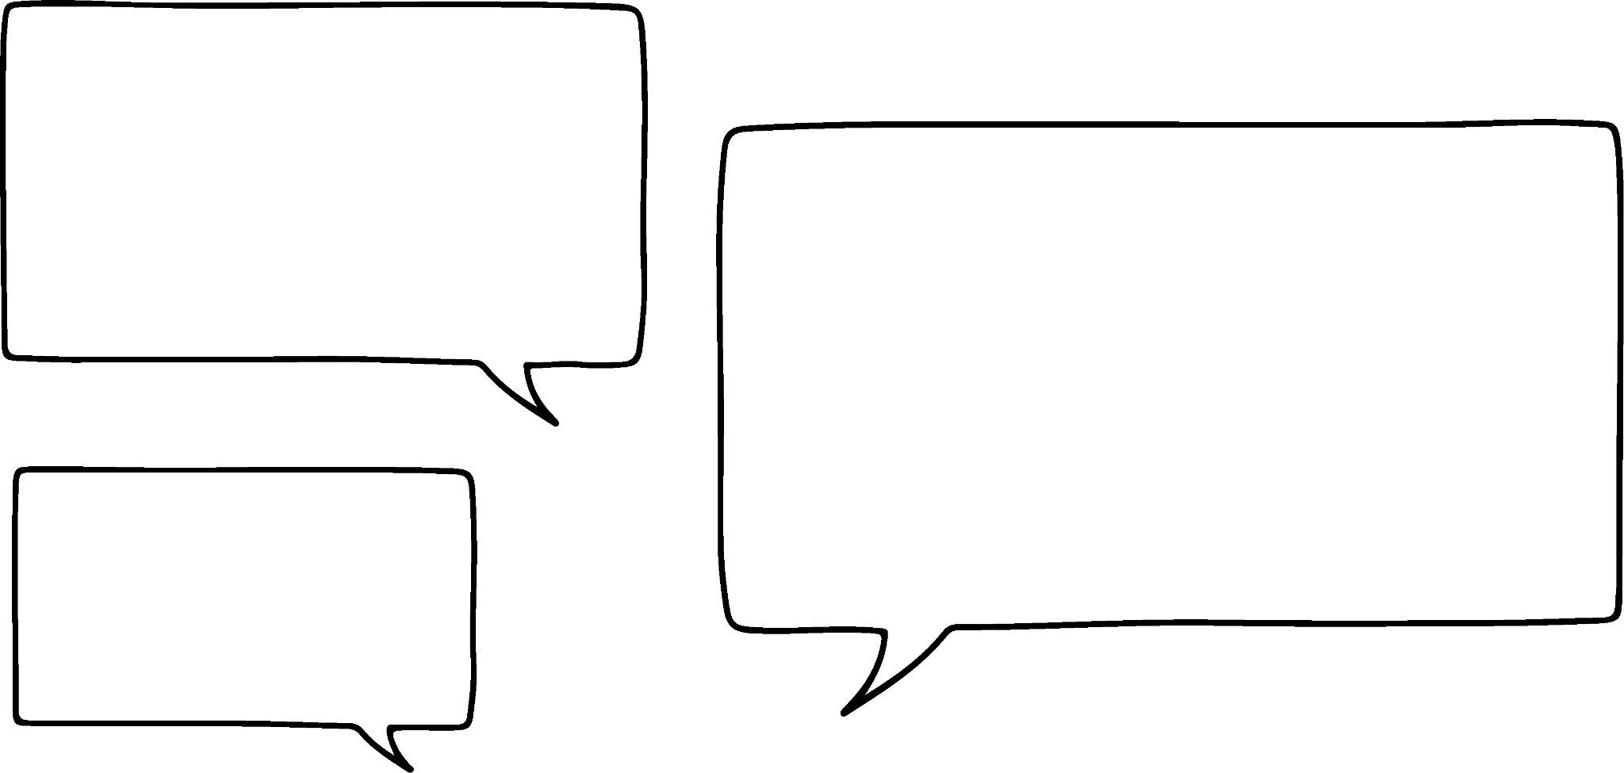




Similarity in shapes
2) Alex, Izzy, Jun and Sam have drawn some quadrilaterals.
This is my quadrilateral.
60°
120°
4 cm
Alex
120°
60°
6 cm
My quadrilateral is similar to Alex’s and all of the edges are twice the length.
60°
120°
8 cm
120°
60°
Izzy
12 cm
My quadrilateral is not similar to Alex’s, even though all the edges twice the length.
8 cm
8 cm
Jun
12 cm
12 cm
My quadrilateral is not similar to Alex’s, even all the angles are the same.
120°
120°
Sam
60°
60°
Sketch a possible quadrilateral for Izzy, Jun and Sam.

Slide 3
Similarity in shapes
Task B: Finding similar shapes in complex diagrams
1) Find the value of each unknown.
4 cm
12 cm
5 cm
24 cm
a cm
b cm
12 cm
a = 15 cm
18 cm
b = 16 cm
c cm
60°
6 cm
12 cm
10 cm
15 cm
d cm
d = 4 cm
60°
5 cm
3 cm
30°
c = 20 cm
2) Take a piece of paper and fold it, as shown below.
The paper that does not overlap makes four triangles.
Prove that these four triangles are all similar.
x°
(90 - x)°
Each triangle contains a right angle from the four corners of the paper. Let one angle be x°
Angles in a triangle sum to 180°.
180 − 90 − x ≡ 90 − x
Vertically opposite angles are equal and angles in a triangle sum to 180°. 180 − 90 − (90 − x) ≡ x
All four triangles contain the same angles, so they are all similar.
x°
x°
x°
(90 - x)°
(90 - x)°
Mathematics in Education and Industry
v2.3

